Slide 1
Post-Test
(AI)

Slide 2
(AI) =
Artificial
intelligence

Slide 3
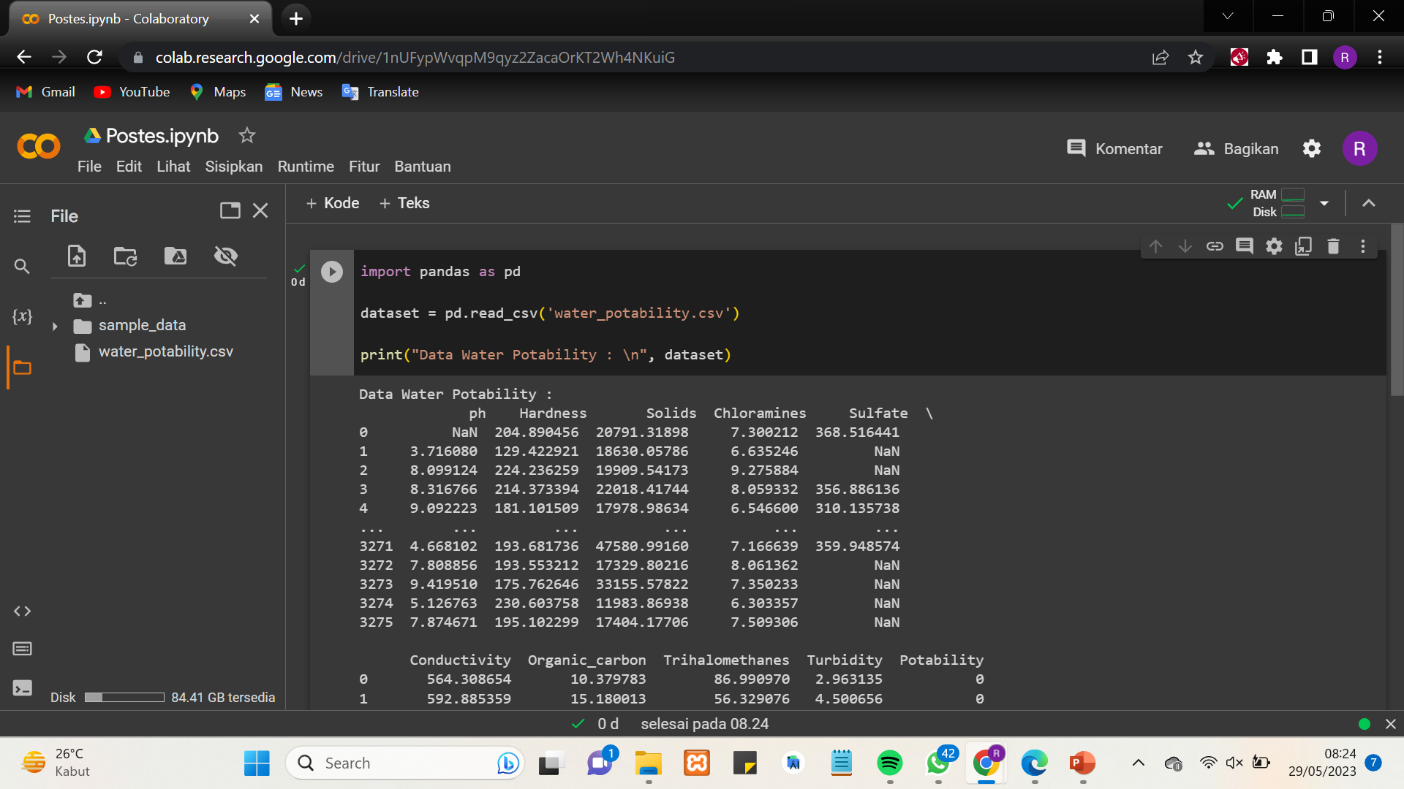
01
(AI)

Slide 4
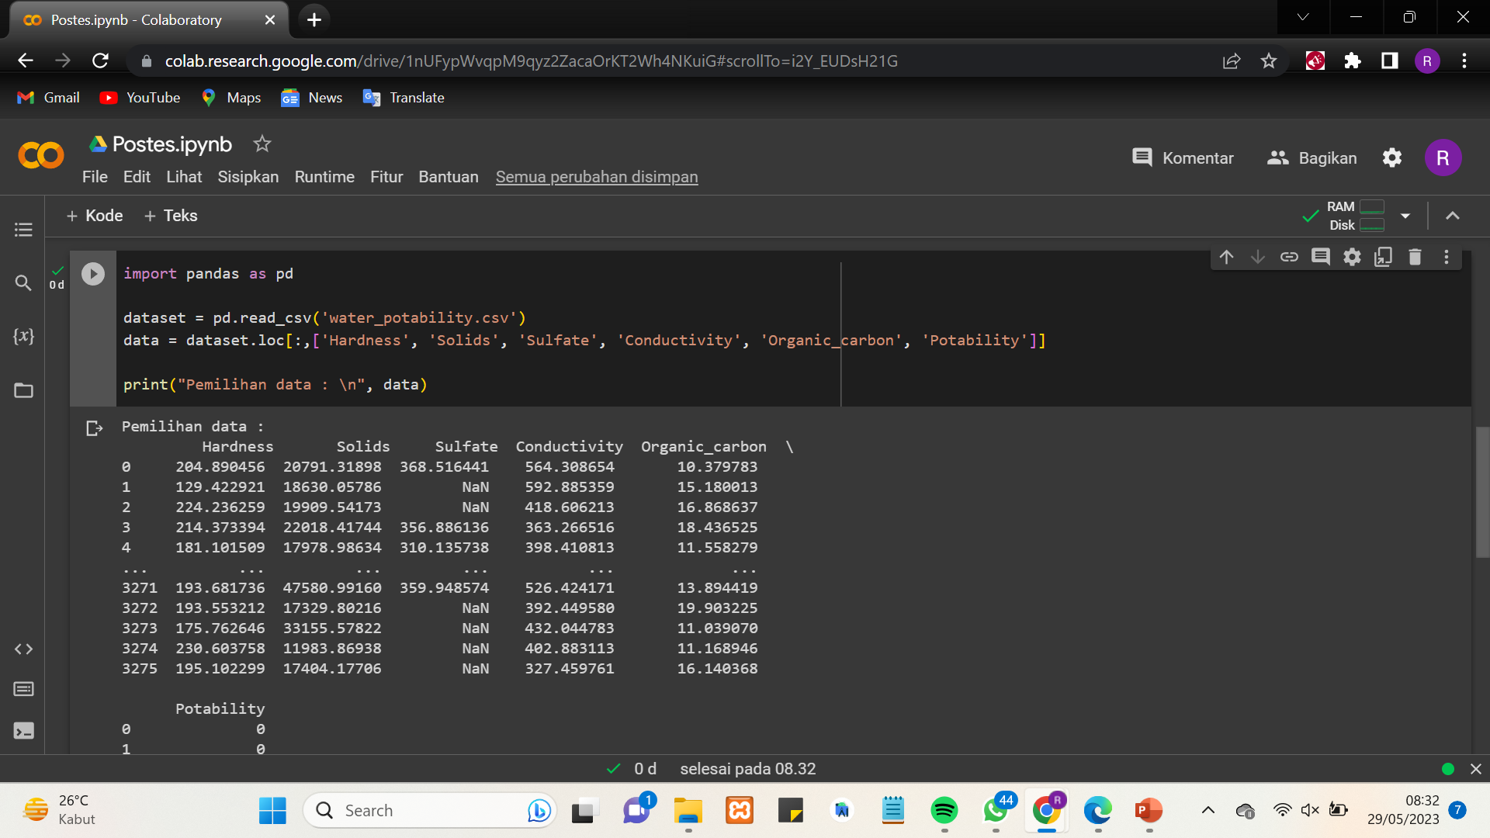
02
(AI)

Slide 5
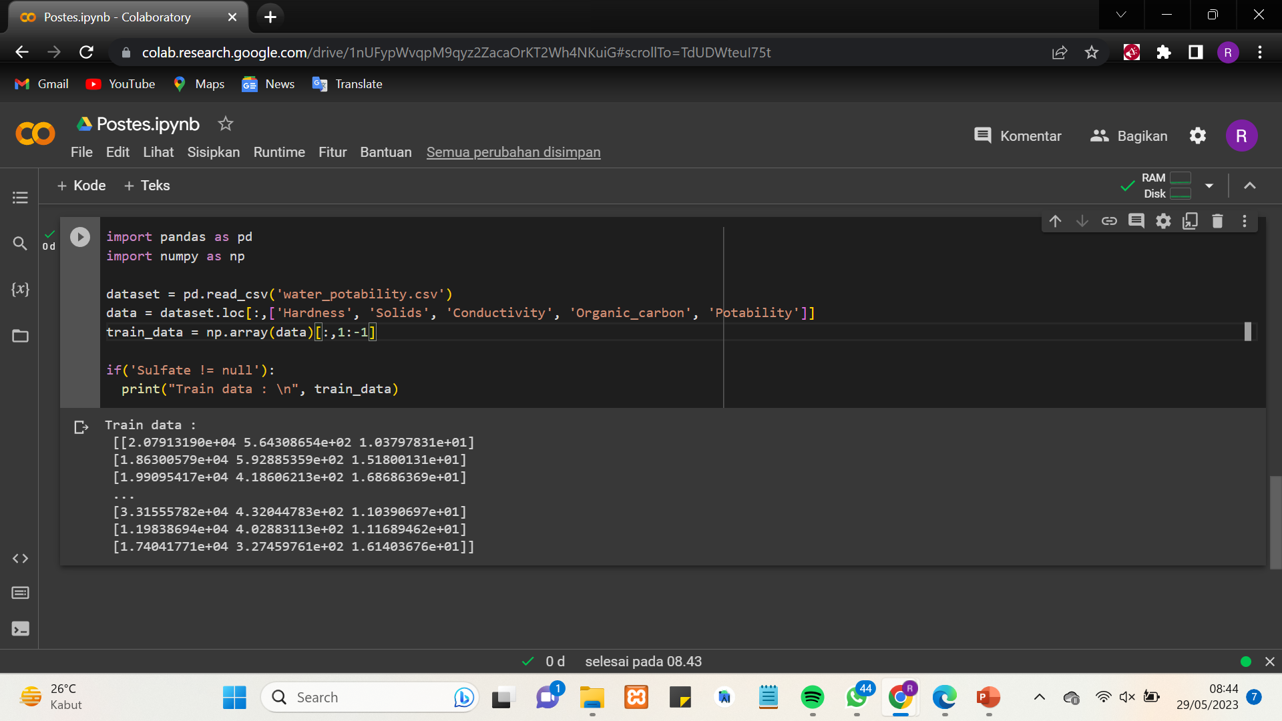
03
(AI)

Slide 6
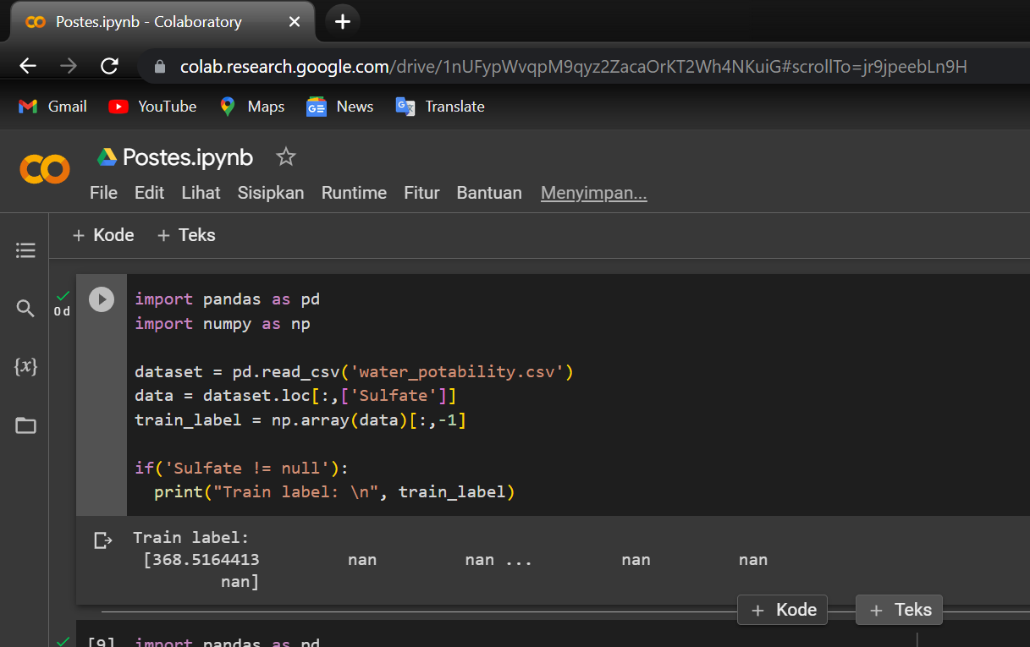
04
(AI)

Slide 7
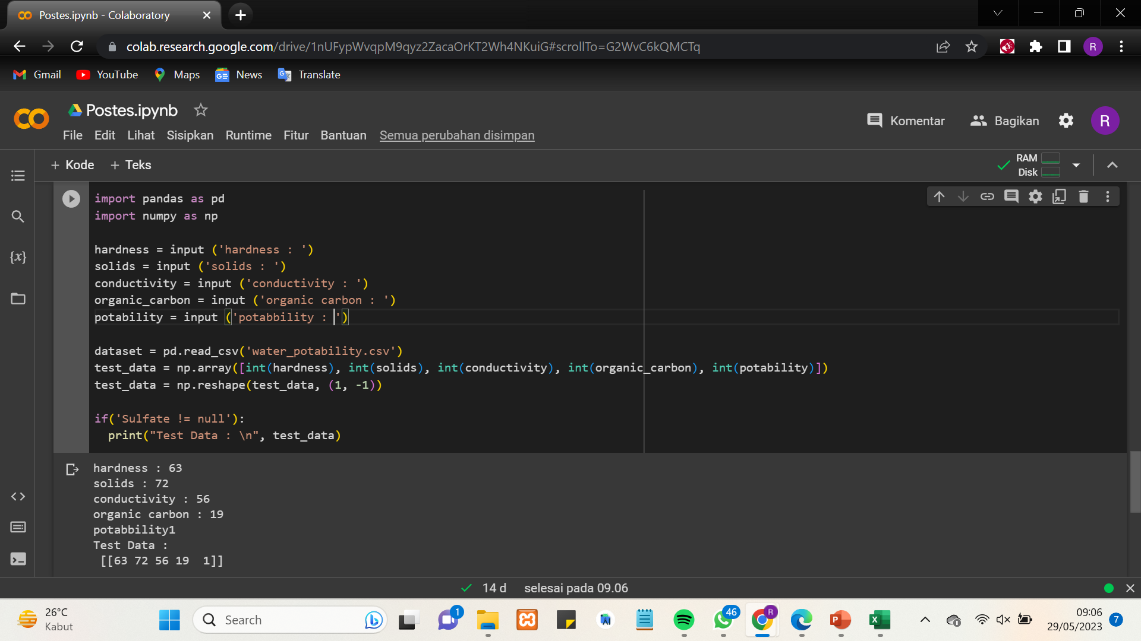
05
(AI)

Slide 8
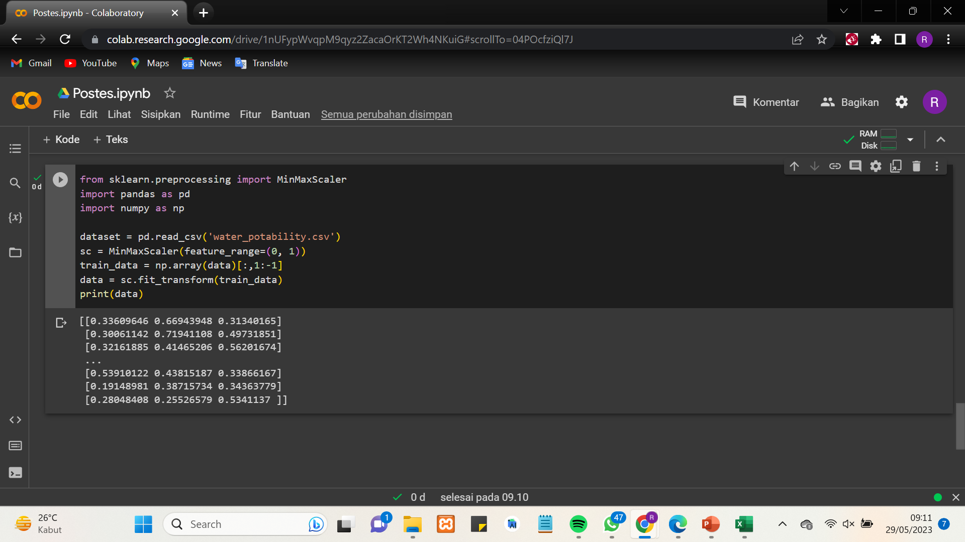
06
(AI)

Slide 9
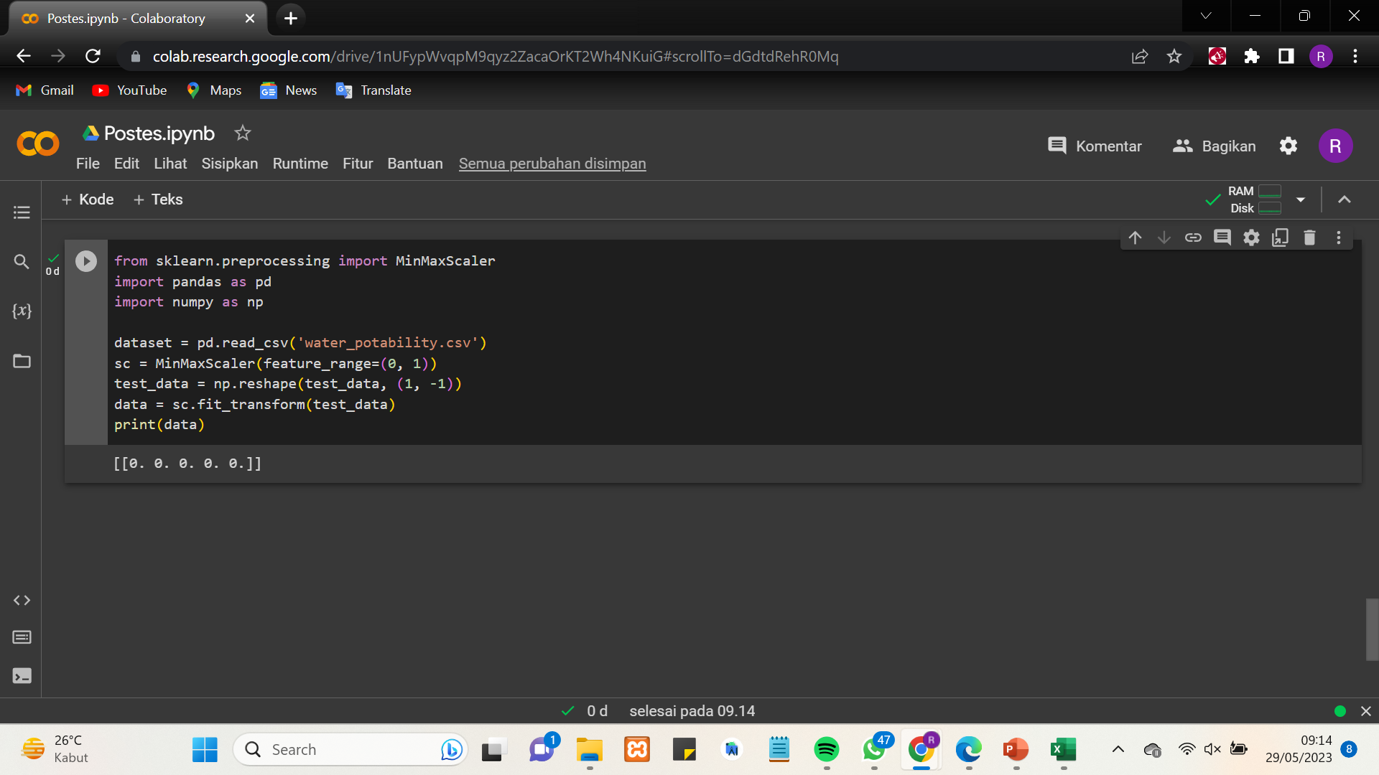
07
(AI)

Slide 10
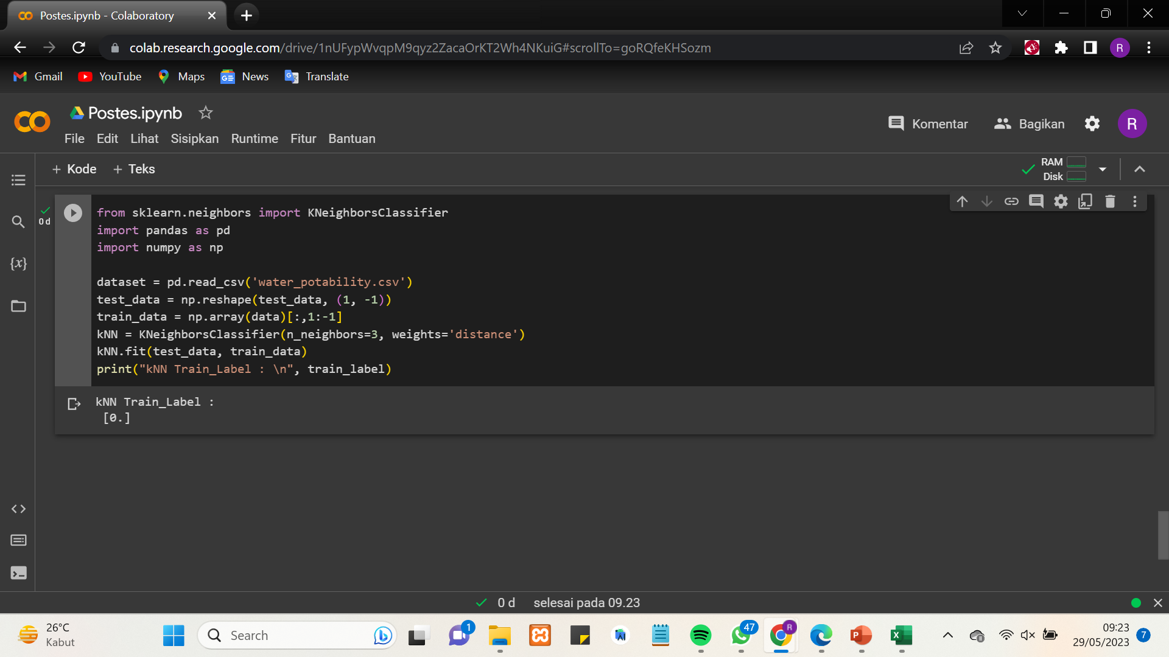
08
(AI)

Slide 11
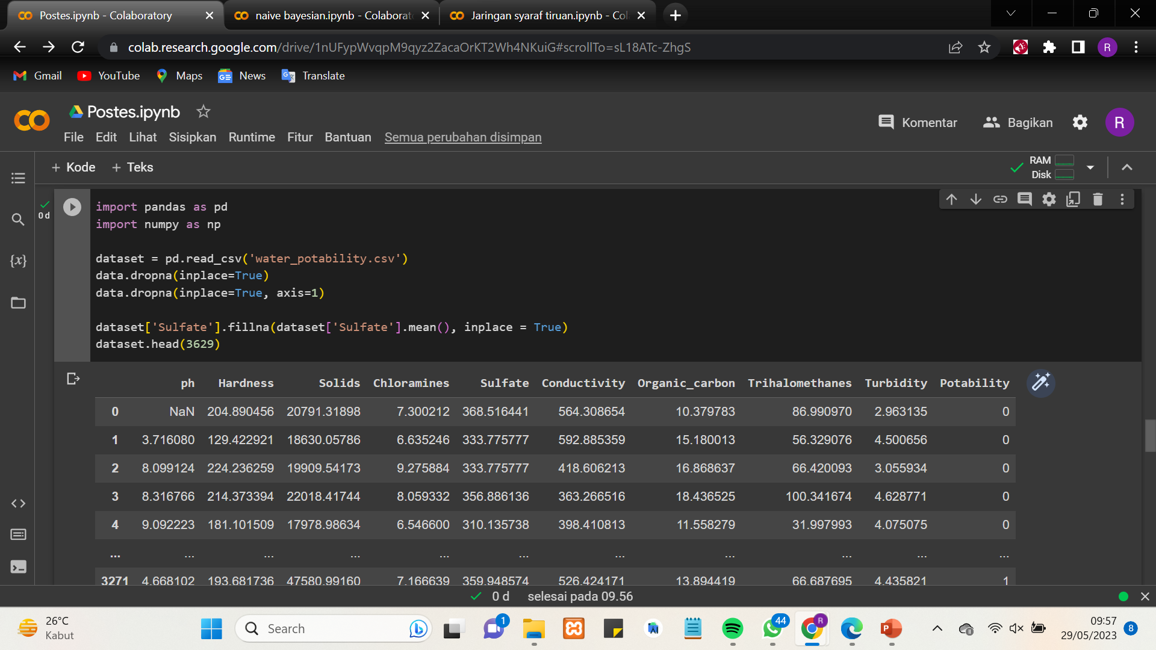
09
(AI)

Slide 12
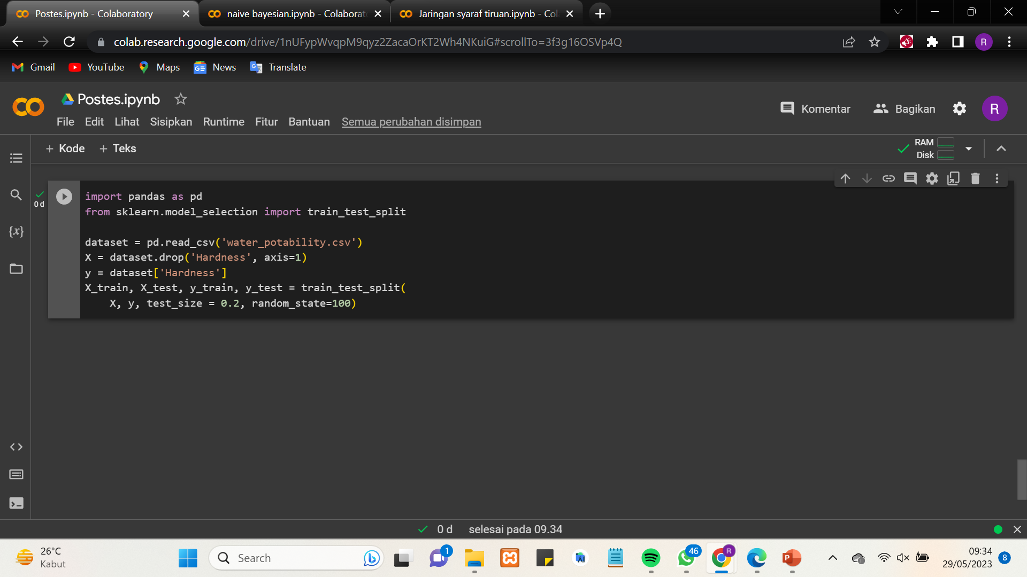
10
(AI)

Slide 13
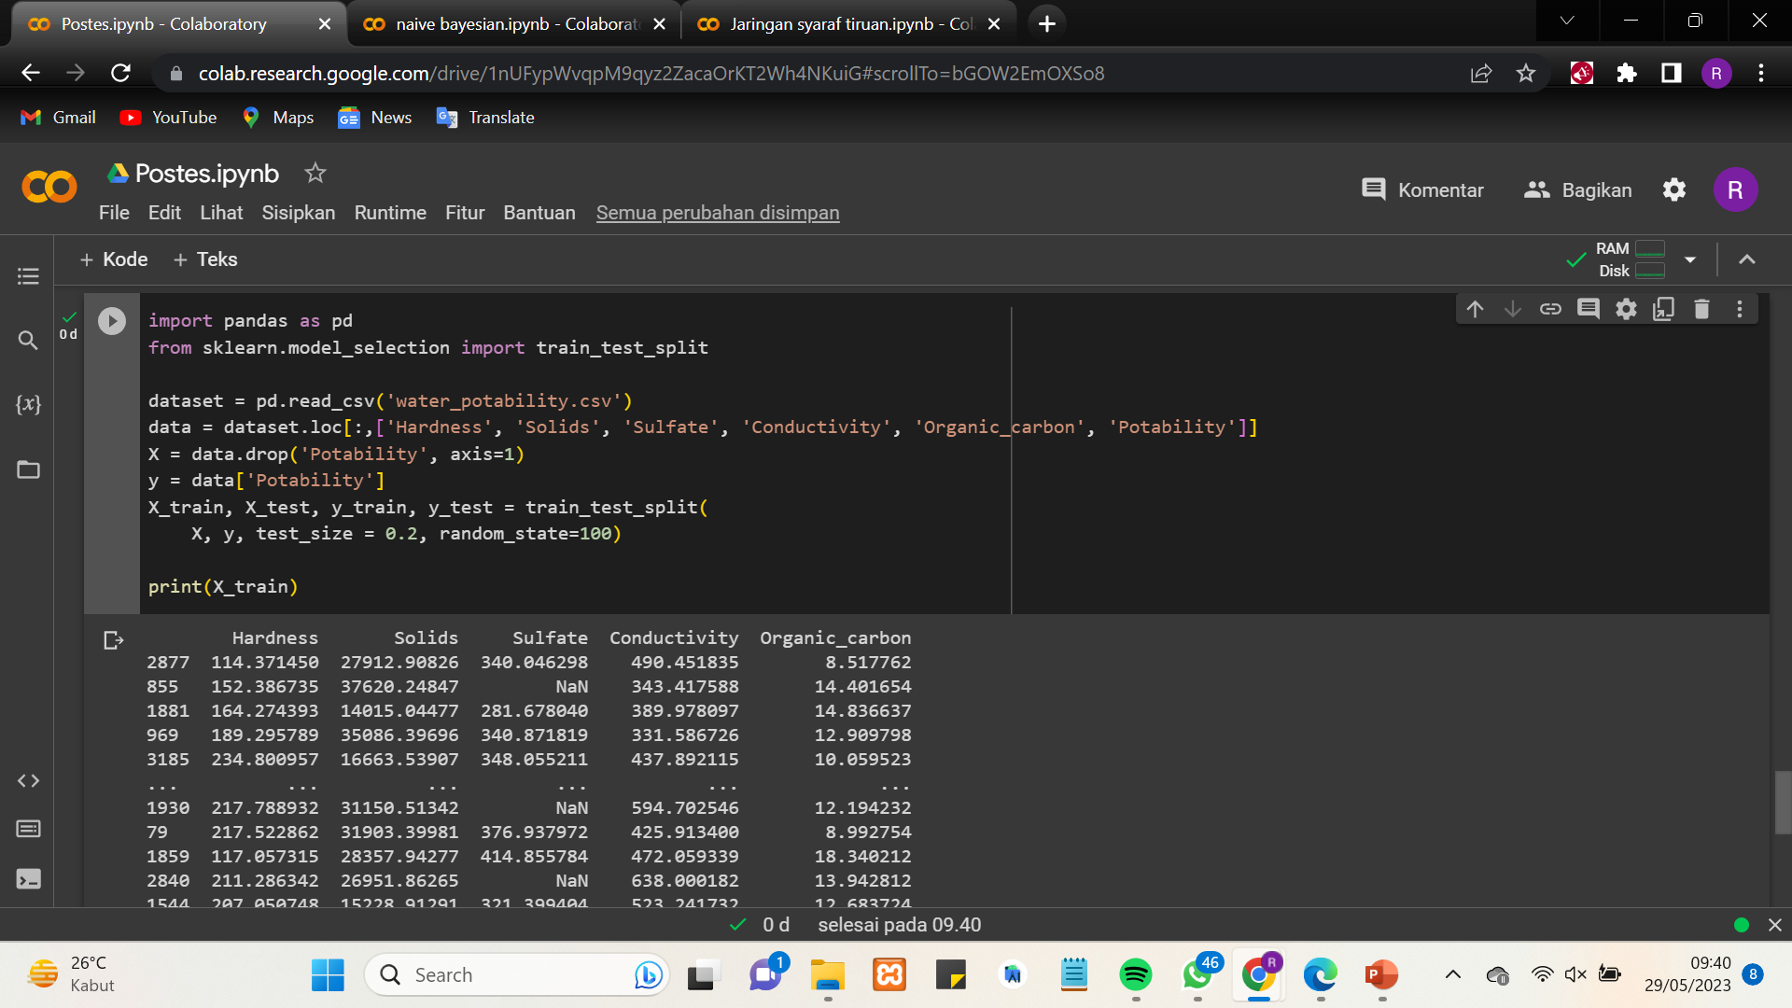
11
(AI)

Slide 14
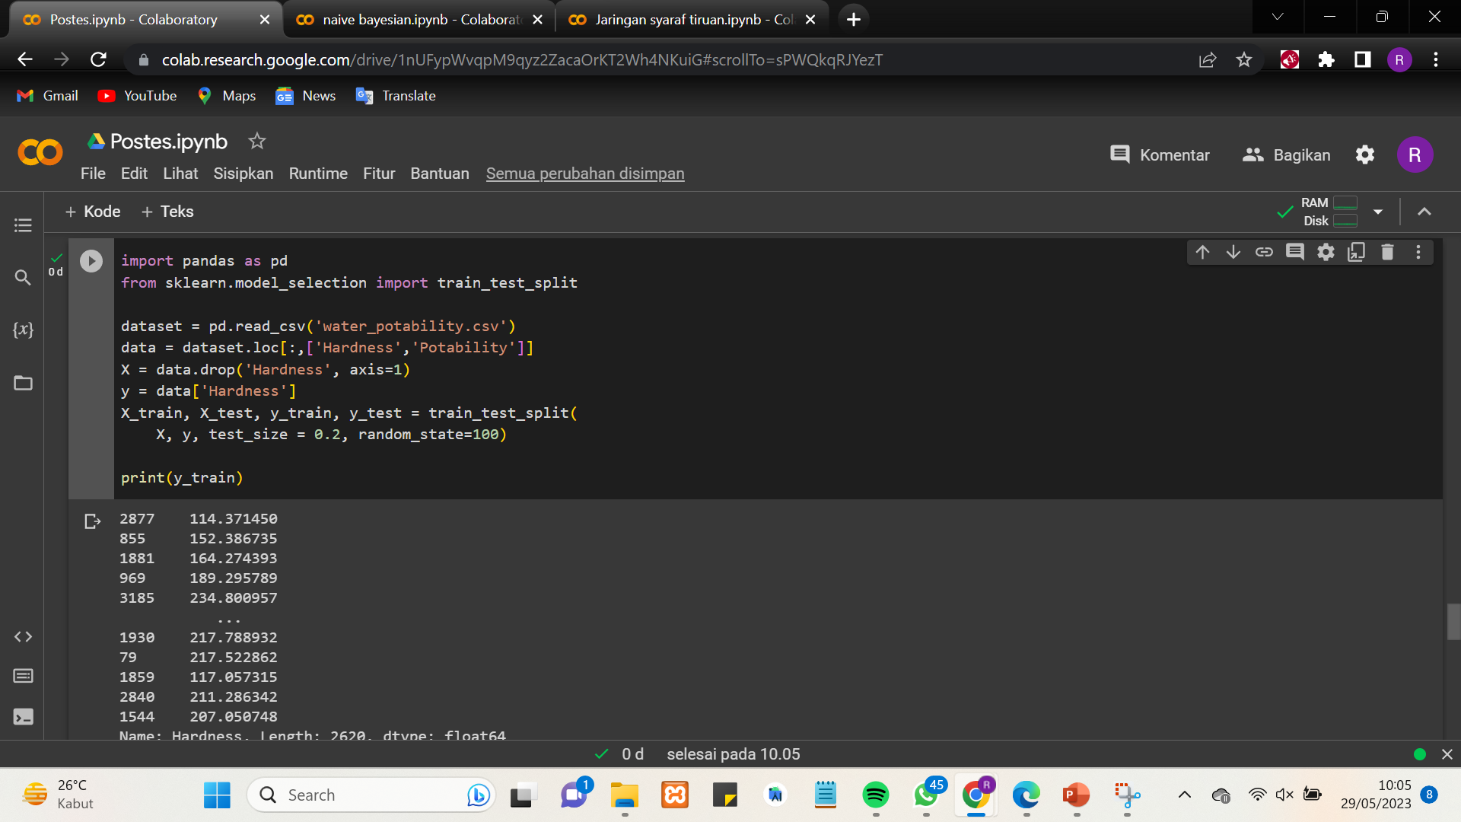
12
(AI)

Slide 15
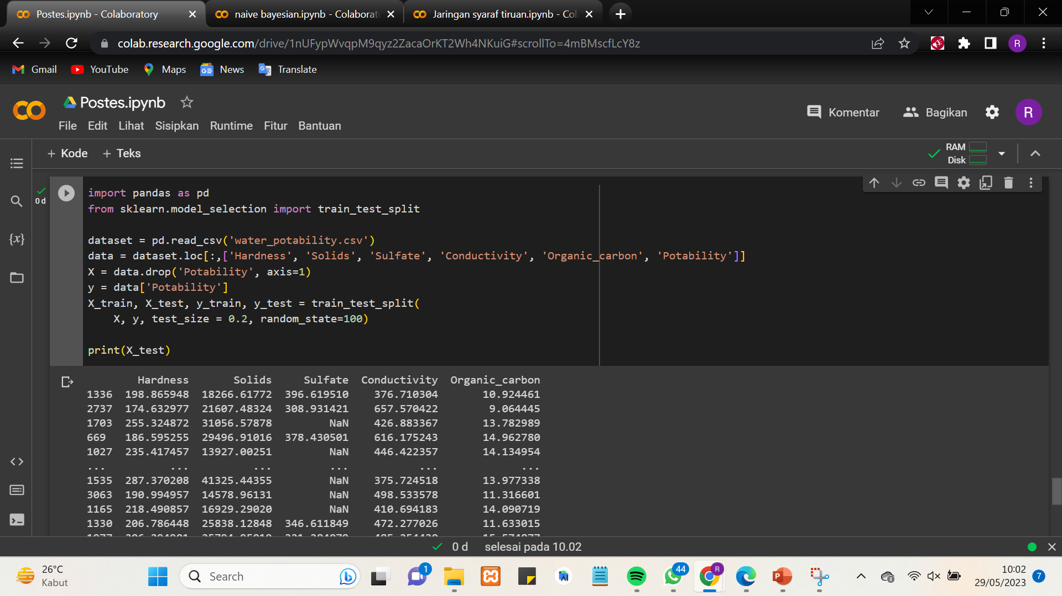
13
(AI)

Slide 16
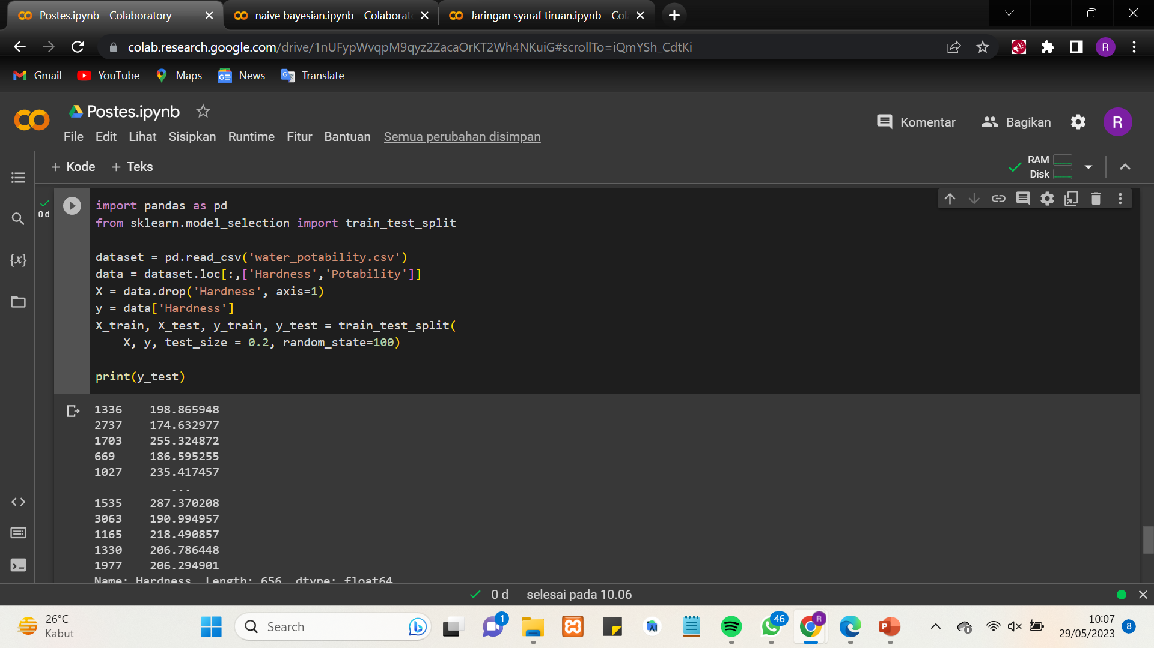
14
(AI)

Slide 17
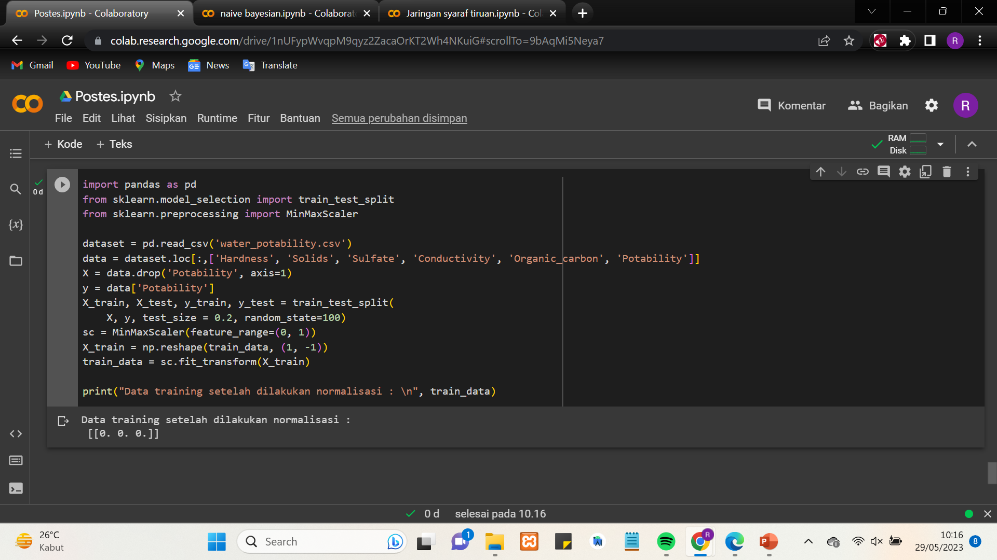
15
(AI)

Slide 18
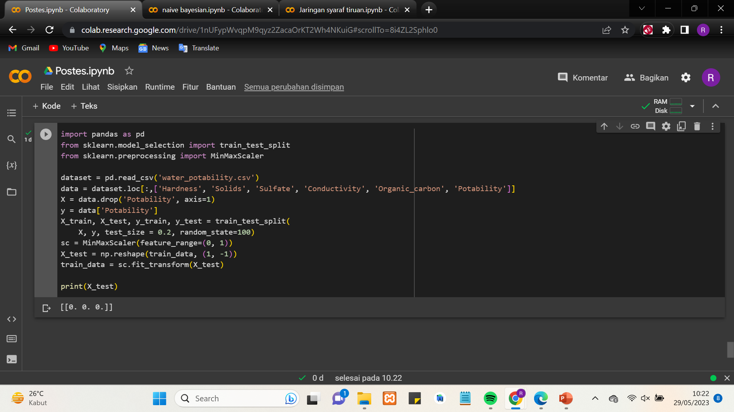
16
(AI)

